Slide 1
Taskify
Presentation By Sandro Zabakhidze & Levan Waqadze

Slide 2

What do we aim to do?
Objective: an unique todo list application designed to transform task management with innovative features and a user-centric approach.
Introduction: we made Taskify, because traditional todo list apps often lack engaging features and fail to address diverse user needs.

Slide 3
Why Taskify?
Problem Statement: Users struggle with maintaining motivation, organizing tasks effectively, and finding a todo list app that suits their personal workflow.
Solution: Taskify addresses these issues by integrating unique features such as gamification, social collaboration, advanced task management, and personalization options.
Vision: To revolutionize task management by creating a more interactive, motivating, and efficient todo list app that caters to modern users’ diverse needs.

Slide 4
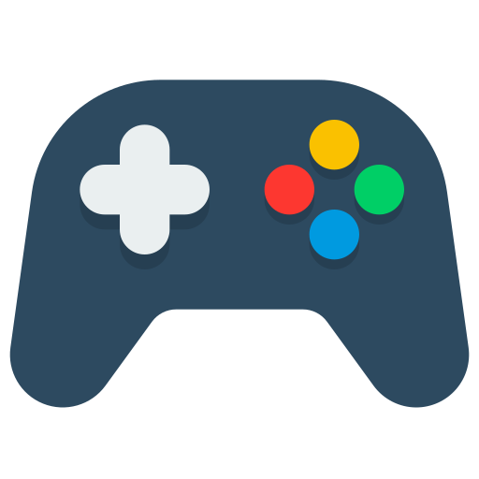
We Offer Simple, Intuitive, Gamified Design

Slide 5
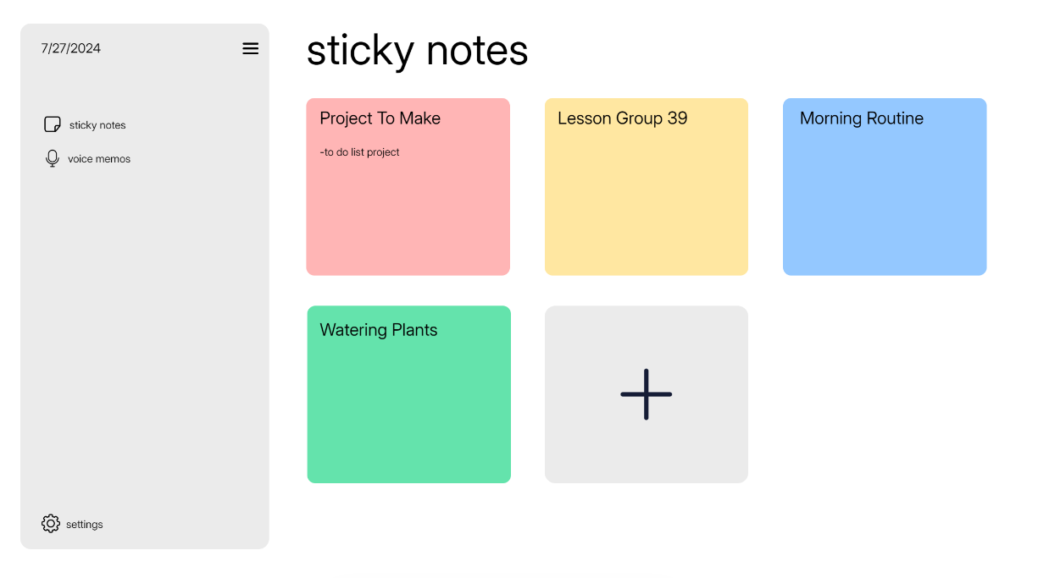
Demo (Homepage)

Slide 6
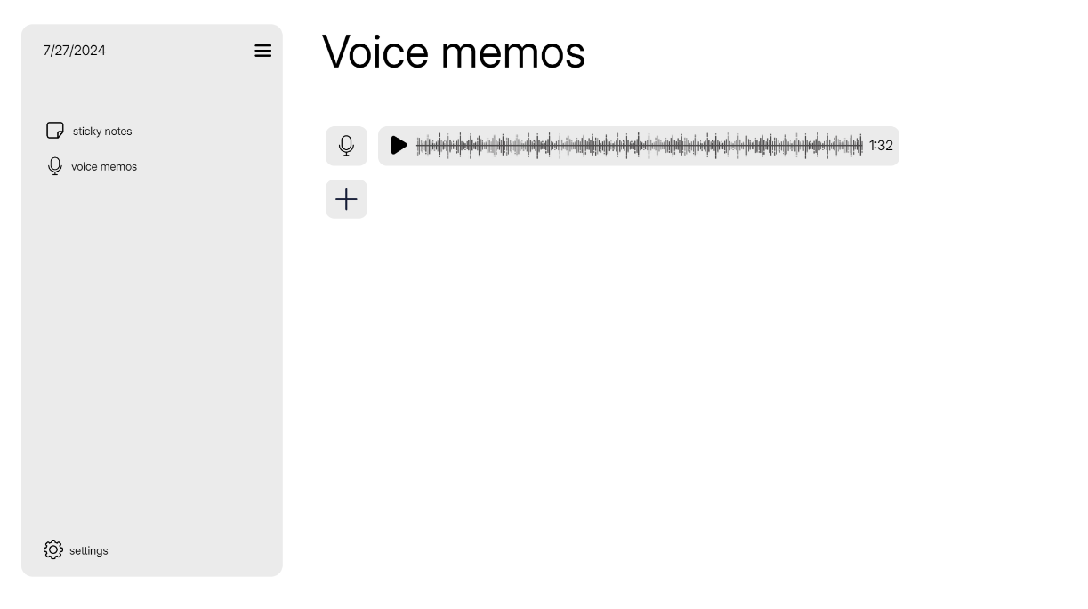
Demo (Voice memos)

Slide 7

Future Features Of Taskify
Personalized Notifications: Allow users to set custom reminders and alerts for specific tasks or deadlines.
Pomodoro Timer: Integrate a Pomodoro timer to assist users in managing their work sessions and breaks.

Slide 8
Thank you for your attention!

